Slide 1





Contract intELIEgence
The Collaborative tool to measure supply chain & service performance
1

Slide 2
Contract intELIEgence is a ….
  Contract repository
  Collaboration tool
  Performance management system
  AI analysis and ML predictive failure technology
  Conversational AI interaction
  Sell contracts to buy contracts
  Control system for spend management
  Development platform to build systems to manage any type of contracts
  Capture platform for auto document on-boarding
2

Slide 3



WHY CONTRACT INTELIEGENCE?
Around 60% of spend is tied to suppliers through contracts, and 90% of income sits within a contractual framework.
But contracts are complex and costly to manage. Clients demand higher performance, driving sharper focus on deliverables. With the shift to consumption-based models, cost control has never been more critical.
Success now depends on:
Contract Obligation
Management
Contract Intelligence
Contract Compliance
Contract intELIEgence gives organisations a single platform to handle today’s contractual challenges.
3

Slide 4



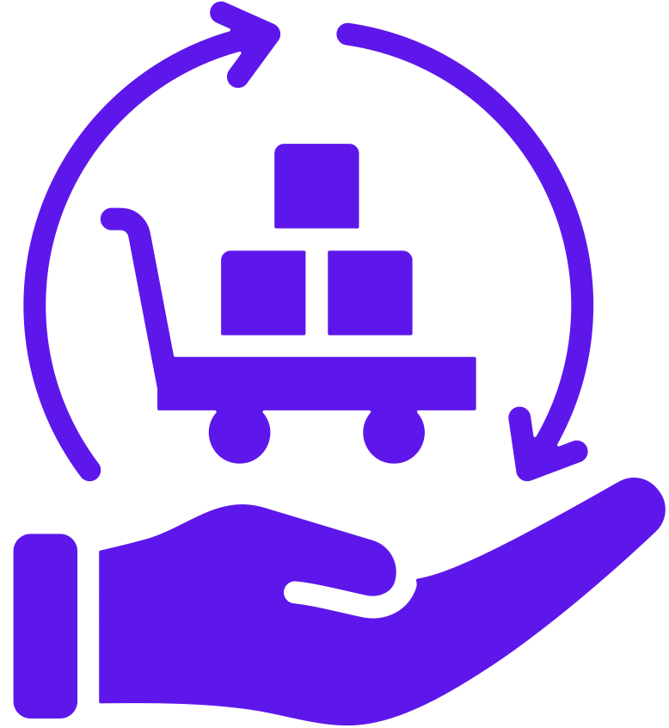


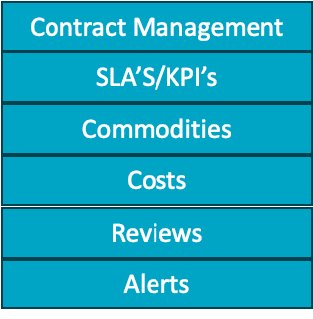











USERS, FEATURES AND DEPENDENCIES OF CONTRACT INTELIEGENCE
Exec’s (CEO,CFO,Legal)
Procurement Team
Sales Team
Stakeholders
Stakeholders
Supplier Portal or askelie access
Customer Portal or askelie access
Services module connects suppliers to
sell contracts or internal services contracts
4

Slide 5









USED ACROSS MULTIPLE PERSONAS
  View Contract Landscape
  Performance views
  Cost views
  Contract renewals
  Change contracts
  View its client contract Landscape
  View performance
  Attend and record review or respond to comments made from client
  Change contracts
Operations
  View Contract Landscape
  Onboard new Contracts
  Contract renewals
  Change contracts
  Facility management
  Assets with contracts
  Under Warranty
Customers
Suppliers
Department Head
  View Contract Landscape
  Onboard new Contracts
  Contract renewals
  Change contracts
  Request new Supplier
  Contract Content
ELIE for
Contracts
Finance
Procurement
  View Contract Landscape
  Verify Contract Costs & Conditions
  Budgets
  Connecting Assets to Contract
  Invoice matching to contract terms
  Manage consumptions costs- SaaS
  Track contractual spend to actual spend
Legal
  View Contract Landscape
  Onboard new Contracts
  Contract renewals
  Process Contract Changes
  Supplier on-boarding
  Contract Repository
  SaaS contracts
  View Contract Landscape
  Onboard new Contracts
  Contract Creation
  Audit/Compliance
  Contract renewals
  Change contracts
  Legal LLM’s
5

Slide 6
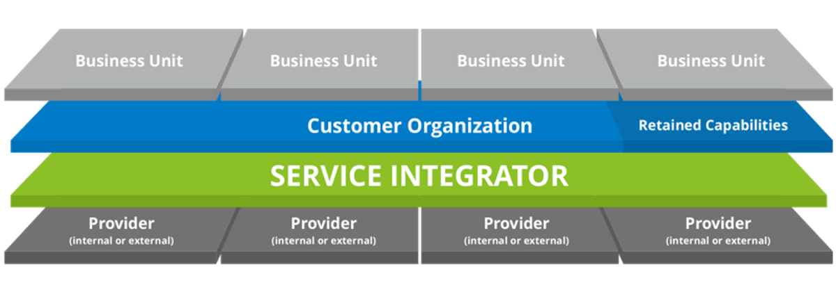

SIAM- SERVICE INTEGRATION & MANAGEMENT MODULE
CI provides a unique end to end view of the Service. This module links the supplier contracts to sales contracts for clients or internal services
Income
Billing
Services
SIAM
Performance
Cost
What is the current
Spend for the
HP contract?
SIAM
Conversation
Chat
Show me the
Supply chain for Marketing app

Slide 7
THE NEEDS - WHY CAPTURE, TRACK AND ANALYSE CONTRACTS & AGREEMENTS?
TO CONTROL SPENDING, AVOID DUPLICATION AND OVER PAYMENT AND MEASURE PERFORMANCE OF BOTH SUPPLIERS AND CLIENT CONTRACTS -
You need:
  Outside of HR, around 60% of business income goes to suppliers and services, with all income tied up in agreements and contracts that demand stronger performance and obligation management.
  The shift to consumption-based pricing creates added pressure on businesses to track and control usage-driven costs.
  Every contract carries risk, and without proper monitoring these risks can quickly turn into operational issues.
  Contracts run across the whole organisation, not just procurement, yet post-contract performance often lacks visibility, driving inefficiency and higher costs.
7

Slide 8
CURRENTLY - SUPPLIER INFORMATION IN SILOS
•Multiple service agreements - managed by different business units
•No single repository - contracts in multiple locations
•No automated link between contract performance and cost
•Increase in consumption based pricing –
pay as you go
•Little collaboration between customers and suppliers across the whole contract life cycle
This leads to:
  No visibility over contract performance
  No single source of the truth
  Difficulties in managing contracts - key dates and clauses hard to find
  Agreements automatically renewed without review
  Payments made without the value being reviewed
  Time lost collecting supplier performance and reviewing
Silos mean losing sight of supplier performance, cost, consumption - and loss of control
8

Slide 9





Contract intELIEgence
02
CLEAR
DASHBOARD
03
COLLABORATIVE
RELATIONSHIPS
01
MEASURES
PERFORMANCE
Dashboard delivers transparency of all performance metrics
Measures contract performance, risk, cost and SLAs
Makes customers/suppliers relationships collaborative and automated
9

Slide 10

THE NEEDS THAT YOU MUST ANSWER
01
One location for all supplier contracts, SLA’s and KPIs
02
Flagging of poor performing contracts
To control spending, retain contracts and measure performance, you need:
03
Review of suppliers or supplier performance before automatic renewals
04
Control consumption-based costs
05
Better manage contract risk
06
Connection with all aspects of the contract lifecycle
07
A collaboration platform for all stakeholders
10

Slide 11
How Contract intELIEgence can help
Contract Sentinel performance monitor provides:
  Full visibility of service performance to see high and low performing service providers
  An understanding of the true cost of service
  The ability to identify unused services
  A view of how contracts are linked and work together for better portability
  Better management of agreements
  Empowered managers who are able to track internal and external agreements
  Improved supplier performance
  Provide a transparent consumption-based billing solution
  Increased efficiency and access to information
  Provide greater productivity & access by utilising Conversational AI
This allows savings across your business through
the automation of contract performance
11

Slide 12
Benefits of Contract intELIEgence
For Clients
For Suppliers
  Centralised dashboard
  Centralised contract repository
  Centralised workflows
  More collaborative and efficient process
  Visibility of dates, renewals and exit clauses
  Quick retrieval of contracts and terms for review
  Visibility of contract performance
  Consumption based billing clarity
  Full document cloud capture platform
  Give your clients greater transparency over contract services
  Provide greater detail through automation
  Deliver contracts more cost effectively, meeting SLAs and KPIs
  Build a stronger relationship with clients
  Automate management to focus on core business
  Make it easier to do business with you
12

Slide 13
CONCLUSION AND KEY TAKEAWAYS
Contracts drive spend, income, and risk – but are too often hidden in silos.
Visibility and collaboration across all stakeholders is essential.
AI-driven insights turn contracts into active, measurable assets.
Contract intELIEgence gives control, transparency, and savings.
With Contract intELIEgence, every agreement becomes an asset - controlled, measured, and delivering value.
info@askelie.com
13

