Slide 1
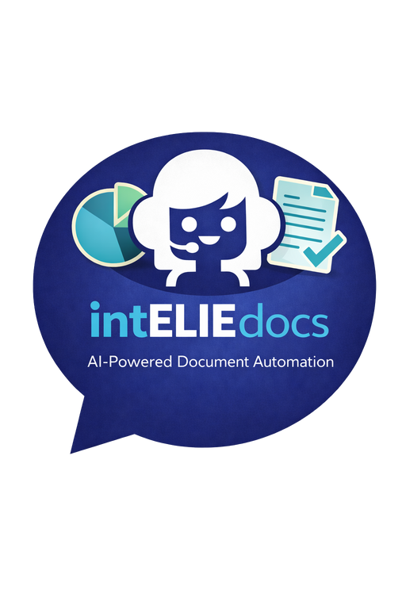



From Paperwork to Productivity: How intELIEdocs Transforms Document Handling

Slide 2



Introduction
Every organisation relies on documents. From invoices and contracts to medical forms and government applications, paperwork drives decisions. The problem is, handling documents manually is slow, error-prone, and expensive. Compliance demands make it even harder, with GDPR, ISO 27001, and industry regulations leaving no room for mistakes.
That’s where intELIEdocs comes in. Built by askelie, intELIEdocs is an AI-powered document processing engine that extracts, validates, and routes information with unmatched speed and accuracy. It’s designed for any environment, even high-volume, high-compliance, helping teams turn documents into decisions without the drag of manual work.

Slide 3
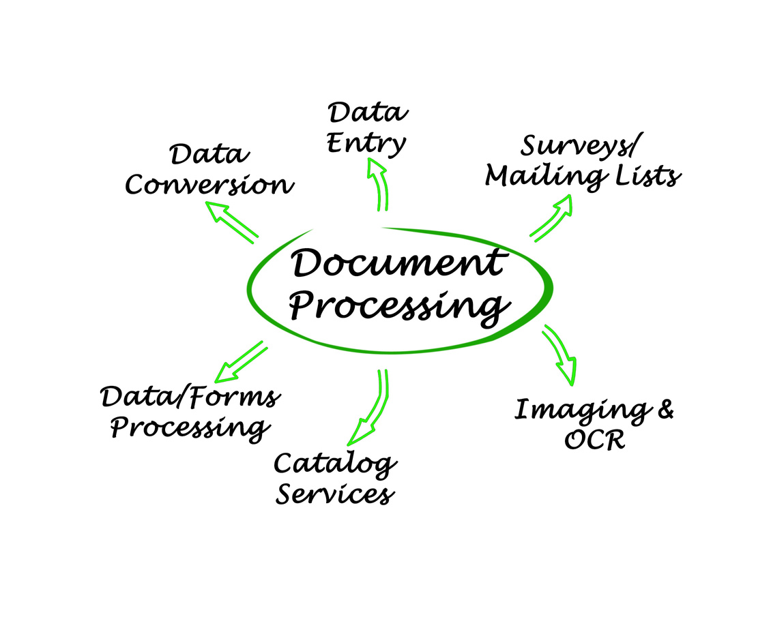
What is intELIEdocs?

Slide 4


intELIEdocs is more than OCR. It’s intelligent document processing that:
Captures data from structured, semi-structured, and unstructured documents.
Validates information instantly against business rules and compliance standards.
Connects seamlessly to your existing systems, CRMs, ERPs, and databases.
Keeps humans in control with optional review steps where needed.
In short: it automates the admin, protects compliance, and delivers the accuracy your business depends on.

Slide 5


How It Works
Ingest - Capture documents from email, uploads, or system integrations.
Extract - AI reads and understands data at both field and context level.
Validate - Built-in compliance checks ensure accuracy and regulatory alignment.
Deliver - Data and decisions are sent to the right systems, people, or workflows.
Think of it as an always-on digital team member, turning stacks of documents into clean, usable data - instantly.

Slide 6


Key Features
Universal Document Handling – Works across industries and formats.
AI-Powered Data Extraction – Proprietary models capture fields and context with human-level accuracy.
Built-In Compliance – Automatically applies GDPR, ISO 27001, and internal business rules.
Smart Validation – Flags anomalies, missing fields, or inconsistencies before they cause problems.
Seamless Integration – Connects with your CRMs, ERPs, databases, and workflow systems.
Human-in-the-Loop – Add human checks where assurance is critical.

Slide 7

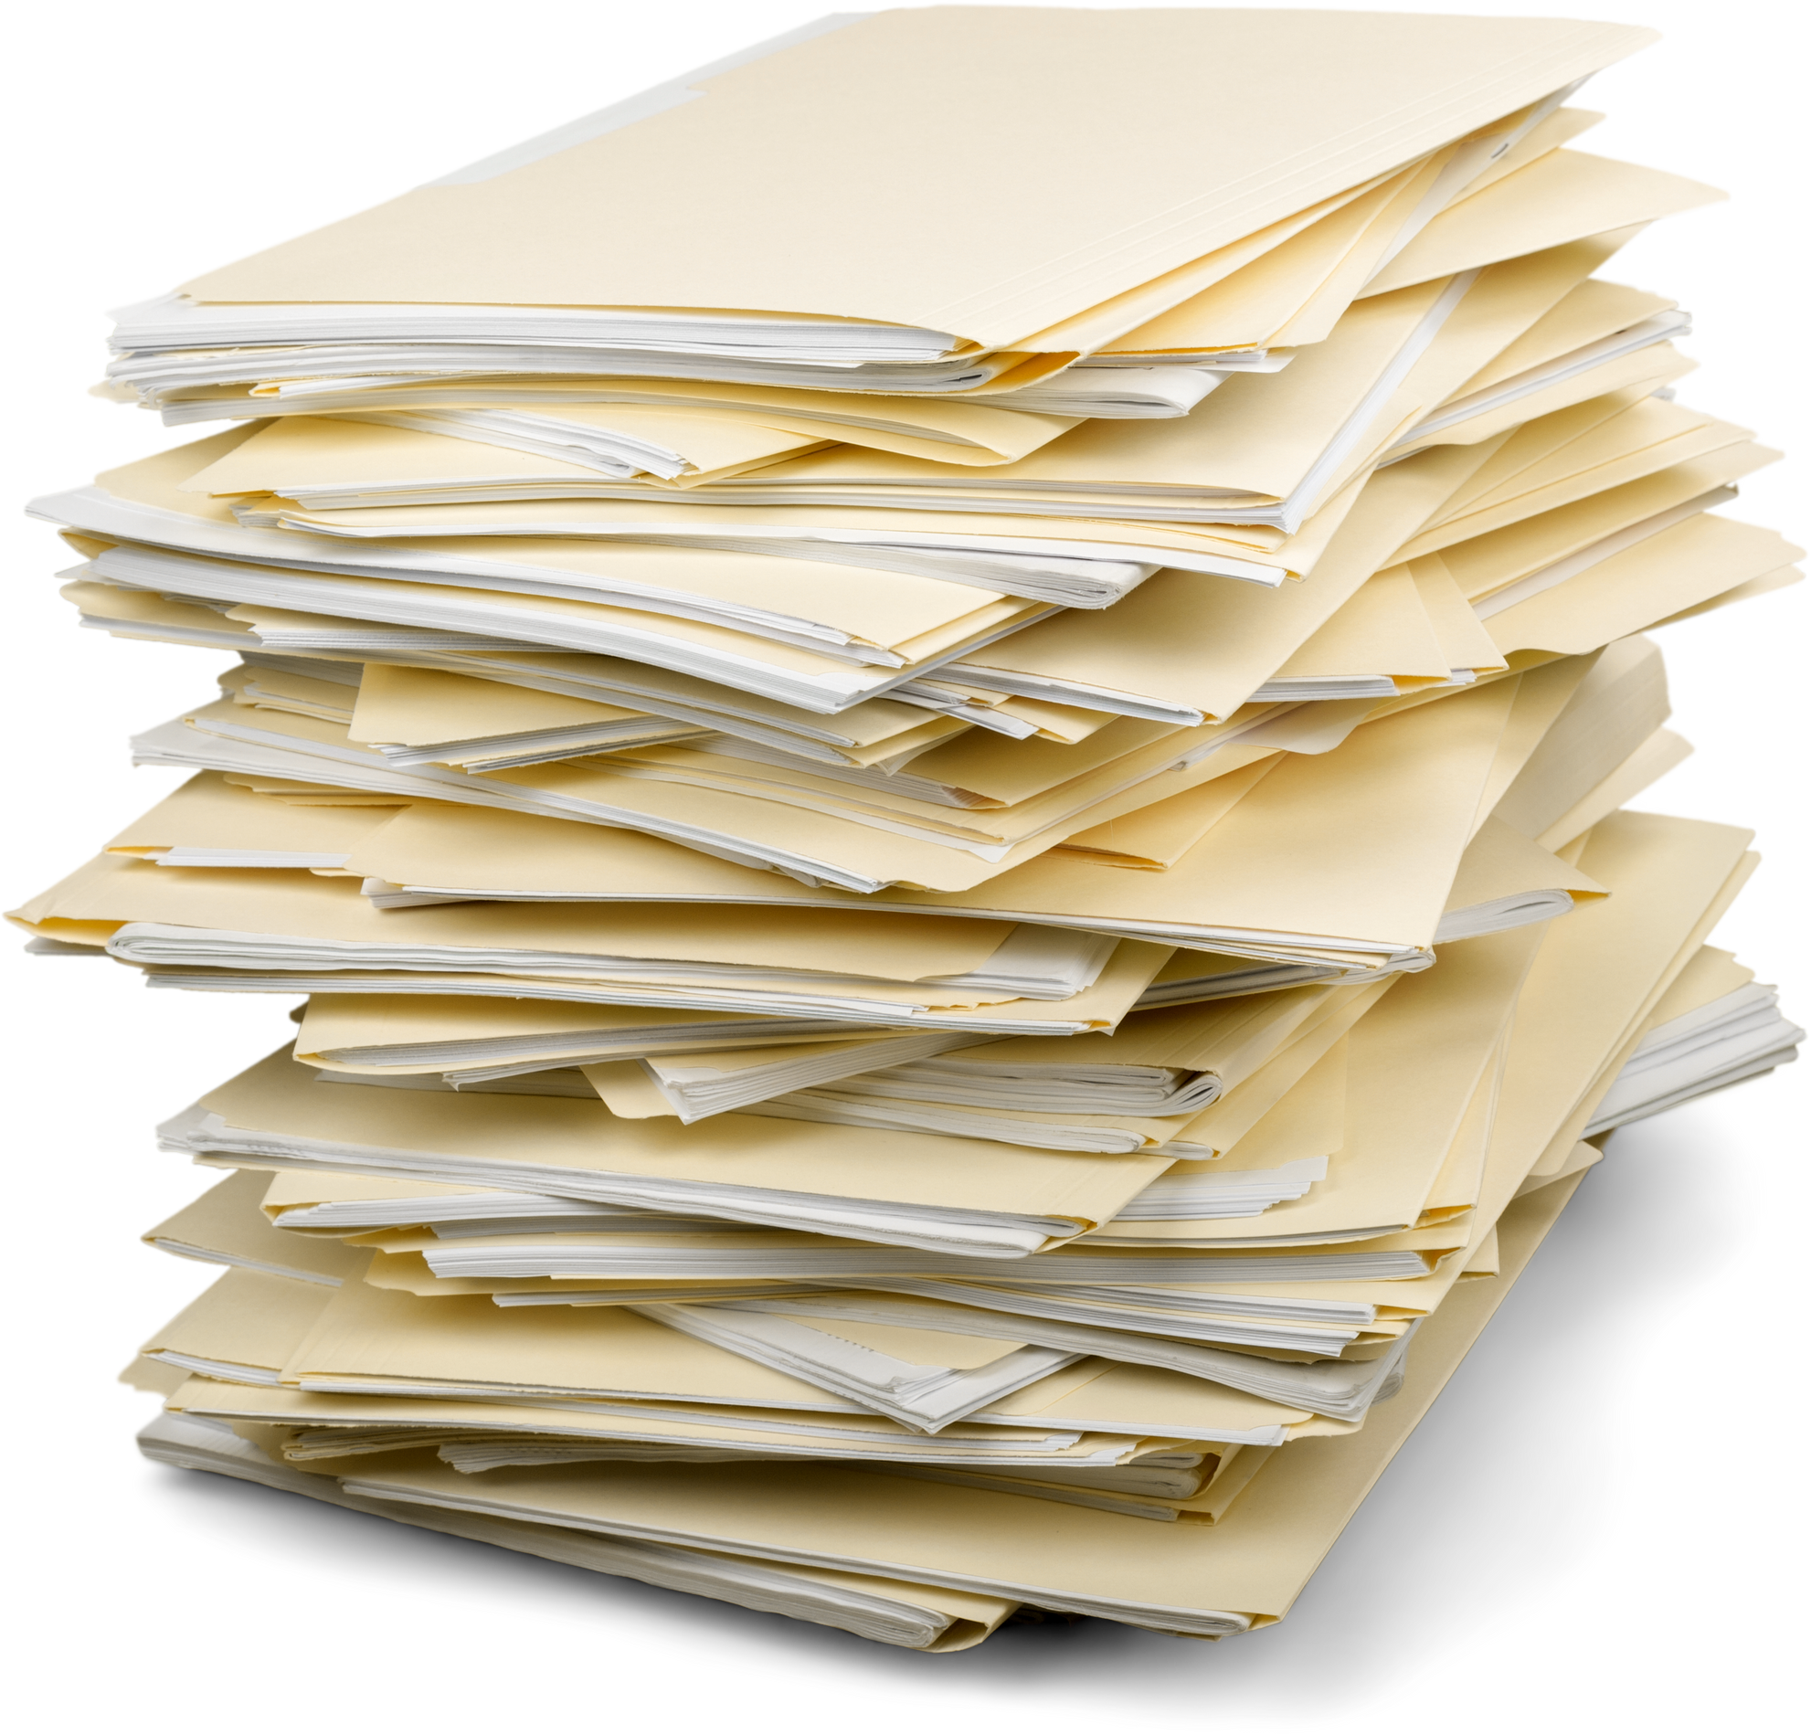
Benefits and Outcomes
Time Savings – Free teams from repetitive data entry.
Faster Onboarding – Speed up client and customer journeys.
Better Compliance – Every document is audit-ready by default.
Increased Capacity – Process more cases without adding headcount.
Lower Costs – Replace manual admin and outdated OCR tools.

Slide 8


Use Cases
Finance & Accounts Payable
Automate invoice capture, validation, and approvals to cut processing time and reduce payment errors.
Legal & Contract Management
Extract key terms, clauses, and renewal dates from contracts to stay compliant and avoid missed obligations.
Healthcare
Process patient records, referrals, and medical forms securely, with full data privacy controls.
Insurance
Accelerate claims intake, policy checks, and evidence validation to deliver faster outcomes.
Government
Digitise and automate citizen forms, benefit applications, and licensing paperwork to improve public service delivery.

Slide 9

Why Choose intELIEdocs over OCR?
Traditional OCR tools scan text. intELIEdocs understands documents.
AI comprehension delivers >99% accuracy on critical fields.
Compliance is built-in, not bolted on.
Scales to millions of documents without additional staff.
Delivers real outcomes - not just digital copies.

Slide 10


Pricing Overview
intELIEdocs is priced around document models.
One model = one document type.
Example: If you process invoices, purchase orders, and contracts, you’ll need three models.
Models can be added as you scale, ensuring you only pay for what you need.
A simple calculator makes it easy to estimate costs and ROI.

Slide 11


Frequently Asked Questions
Q: What types of documents can intELIEdocs process?
A: Structured, semi-structured, and unstructured documents across multiple industries.
Q: How accurate is the data capture?
A: Our proprietary models deliver over 99% accuracy on critical fields, rivaling human review.
Q: Can intELIEdocs integrate with my existing systems?
A: Yes. It connects to CRMs, ERPs, and databases with minimal disruption.
Q: Is my data secure?
A: Yes. intELIEdocs is aligned to ISO 27001, encrypts data end-to-end, and supports GDPR compliance.

Slide 12

Conclusion: From Paperwork to Productivity
Documents don’t have to slow your business down. With intELIEdocs, every file becomes a fast, accurate decision - delivered straight into your workflows.
See how askelie can transform your operations.
Book a demo today.

