Slide 1


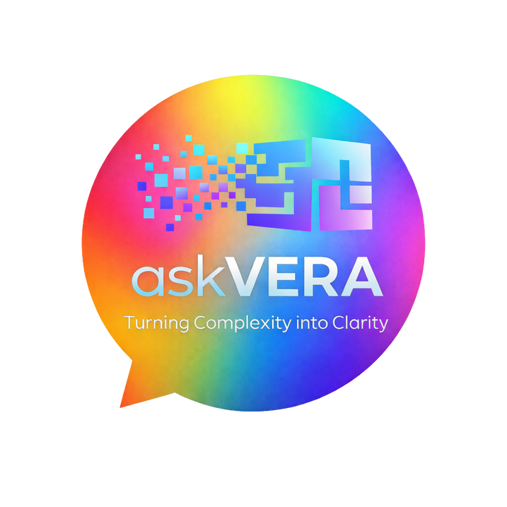
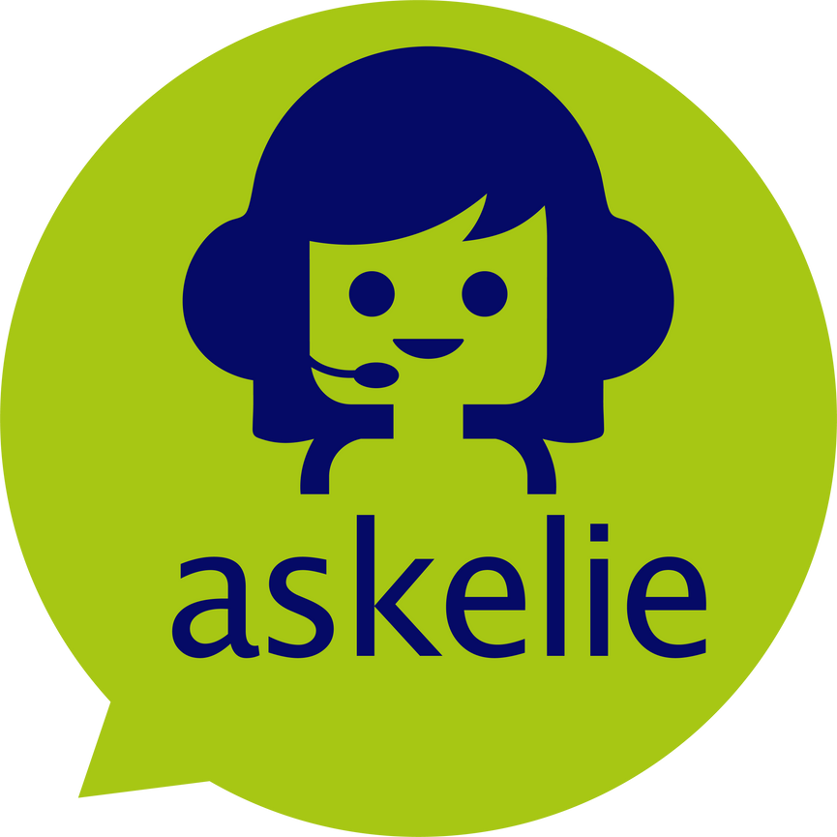
The How, What, When and Why of Easy Read
with
askVERA

Slide 2


Introduction
Let’s start with a question: on a scale of 1–10, how confident are you that all of your organisation’s communications are accessible to everyone who needs them? Keep that number in your head.
If it’s anything less than 10, then this e-book could be one of the most useful things you’ll read this year. Why? Because accessible communication is no longer a nice-to-have, it’s a legal, ethical, and reputational necessity.
The truth is, the world has changed. Public expectations of inclusion, equality, and clear communication are higher than ever.
Regulations such as the Equality Act and WCAG standards make accessibility a legal requirement. And most importantly, people expect information they can understand, right away.
AskVERA is designed to help you meet these expectations. She takes complex text, whether that’s policies, forms, or guides, and turns it into Easy Read: plain, clear documents with supportive images and symbols.
This e-book sets out the what, when, why, and how of Easy Read, and shows how AskVERA can transform the way you communicate.

Slide 3


Part One:
The What, When, and Why of Easy Read

Slide 4



The Big Accessibility Problem
Too many people are left out of important conversations or access to services because information is too complex. Whether it’s healthcare instructions, council policies, or workplace training, if people cannot understand it, they cannot act on it.
Research shows:
1 in 7 adults in the UK have literacy levels expected of an 11-year-old or lower.
Over 1.5 million people in the UK have a learning disability.
Many communities rely on English as a second language.
That means millions of people risk being excluded every day if organisations don’t make their communication accessible - exclusion isn’t just unfair, it creates real risks. Patients who can’t follow health guidance may be harmed. Citizens who can’t understand council letters may miss deadlines. Employees who don’t grasp workplace policies may face barriers to work.
AskVERA
AskVERA
AskVE
AskVERA

Slide 5


The Case for Easy Read
Easy Read is a communication format that uses:
Short, plain sentences
Simple layouts
Supporting images and symbols
It helps people with learning disabilities, low literacy, or limited English to understand. But its benefits extend to everyone. Clearer communication builds trust, reduces errors, and improves compliance.
Key Takeaway
Accessible communication isn’t optional. It’s essential for legal compliance, social inclusion, and organisational credibility.

Slide 6

Part Two:
The How of
Easy Read with AskVERA

Slide 7

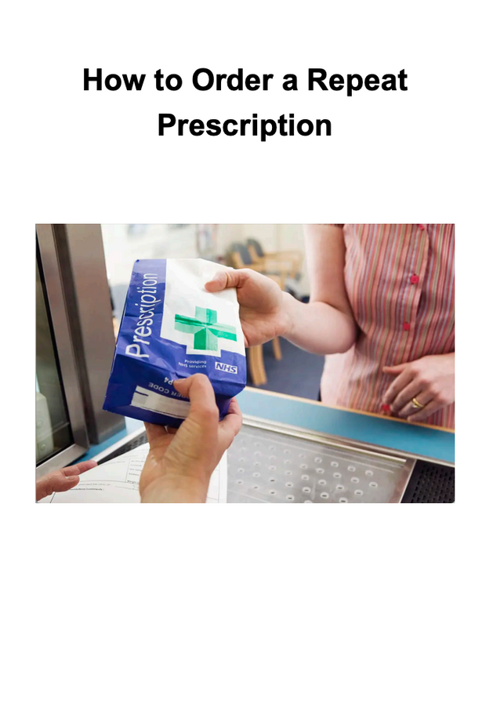
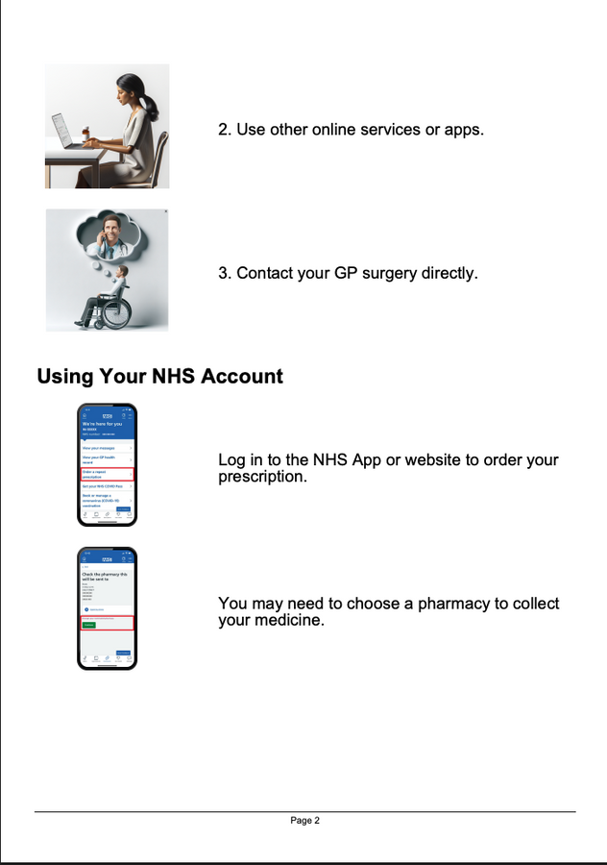
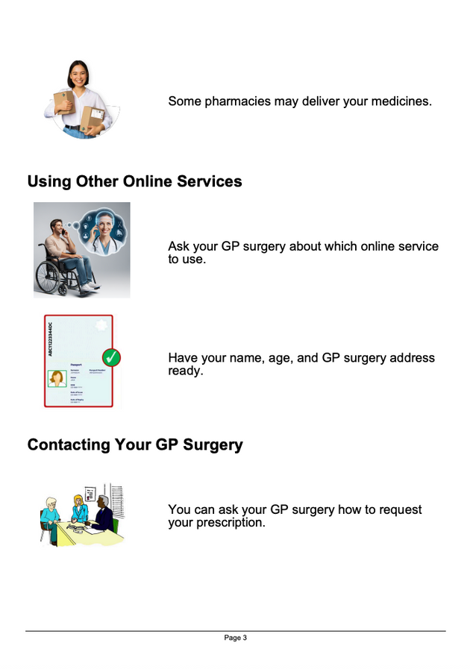
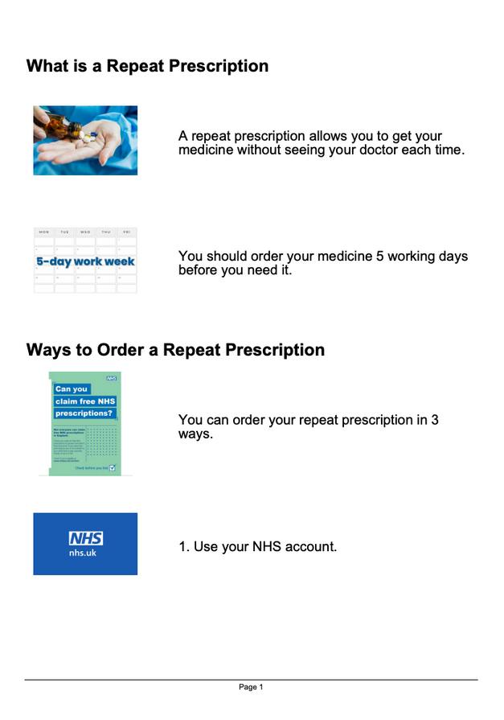

The Modern Accessibility Platform
AskVERA is not just a tool, she’s your digital Easy Read assistant.
Here’s what she does:
Automated conversion: instantly turns policies, forms, and guides into plain language Easy Read formats.
Image and symbol support: adds simple visuals to reinforce meaning.
Custom branding: ensures your Easy Read documents still look like yours.
Compliance ready: built to help meet Equality Act and WCAG accessibility standards.
Simple to use: no training needed, just upload and go.
Human review: operators can proof, edit, and fine tune the output.

Slide 8


How It Works
Upload your document (PDF or website link)
Transform into plain, accessible language
Enhance with images and symbols
Review for tone and accuracy
Deliver ready for print, download, or email
More Than Just a Conversion Tool
askVERA doesn’t stop at producing a simplified version of your content. She helps you rethink how your organisation communicates. By automating the heavy lifting, askVERA frees your teams to focus on the message itself rather than wrestling with formatting.

Slide 9


Assessing Your Needs
The right Easy Read solution depends on your audience. AskVERA is built for:
Public sector and government services needing clear policies, benefits information, or service updates.
Healthcare providers needing accessible patient communications.
Education and training organisations needing clear learning materials.
Charities and non-profits engaging diverse audiences.
Any organisation that wants to build inclusion and trust.
Key takeaway
AskVERA makes Easy Read scalable, fast, and reliable - turning what used to take hours or days into minutes.

Slide 10


The Top 5 Benefits of Easy Read
Faster, scalable delivery - 90% of the work is automated, so you can create Easy Read at pace across departments.
Compliance built in - Stay ahead of accessibility regulations with documents that align to Equality Act .
Engaging, inclusive communication - Build trust by ensuring people feel included and respected.
Reduced risk - Clear communication reduces misunderstandings, missed deadlines, and costly mistakes.
Stronger organisational reputation - Accessible communication shows leadership and responsibility, values that stakeholders notice.

Slide 11


Real-World Impact
A local authority can convert complex housing policy into Easy Read so tenants clearly understand their rights and responsibilities, reducing confusion and avoiding costly disputes.
A hospital can make discharge instructions clear so patients follow them correctly, improving recovery rates and reducing the risk of readmission.
A charity can share Easy Read guides so service users understand how to get support, helping them access services quickly and feel more confident in doing so.
An education provider can adapt course materials into Easy Read, so learners of all abilities can engage fully with their studies and achieve better outcomes.
A business can create Easy Read versions of workplace policies, ensuring that every employee, regardless of literacy level or language, can participate equally and safely.
In every case, the result is the same: clearer communication, better outcomes for people, and stronger results for organisations.

Slide 12


Your Next Steps
Accessible communication is no longer optional. It’s a requirement, an expectation, and a chance to show your organisation’s values in action.
AskVERA makes it simple. With automation, compliance, and human-in-the-loop review, she helps you create Easy Read documents that truly work for everyone.
Ready to make accessibility part of everything you do?
Visit askelie.io to see how askVERA can help.

